Slide 1
Python (IV)
Pandas
Matplotlib
李育名
amrmm1997@gmail.com
7/17/2020

Slide 2



Pandas
1
https://pandas.pydata.org/pandas-docs/stable/index.html

Slide 3
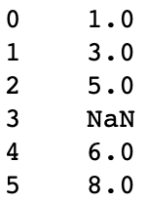
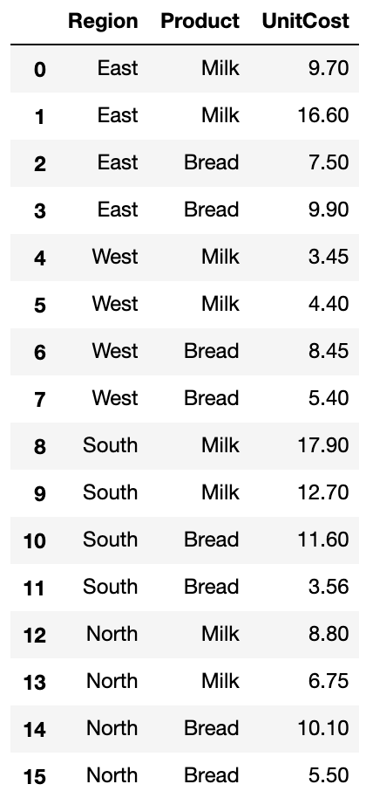
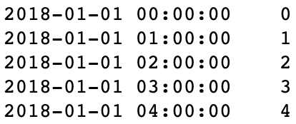
Pandas for different kinds of data
2
Tabular data with heterogeneously-typed columns, as in an SQL table or Excel spreadsheet
Arbitrary matrix data (homogeneously typed or heterogeneous) with row and column labels
Ordered and unordered (not necessarily fixed-frequency) time series data.

Slide 4
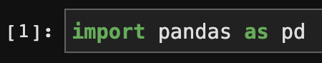
Pandas
3
Import
Object creation
Dimension | Name | Description
1 | Series | 1D array-like object containing a sequence of values and an associated array of data labels, called its index
2 | DataFrame | General 2D labeled, size-mutable tabular structure with potentially heterogeneously-typed column

Slide 5
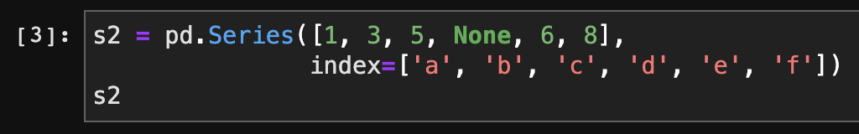
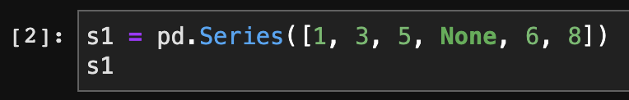
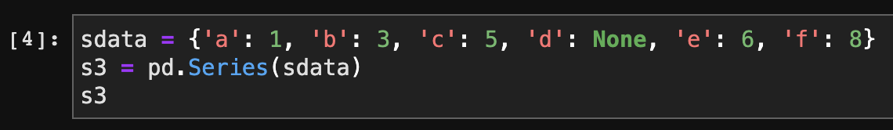
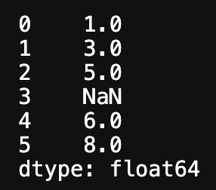
Series
23
pandas.Series -
One-dimensional ndarray with axis labels (including time series).
User-defined Index
List
Select single values or a set of values:
s1[1], s2['b'], s2[['a', 'c', 'd']]
Filter with a boolean array:
s1[s1 > 4], s1[s1.isnull()], s1[s1.notnull()]

Slide 6
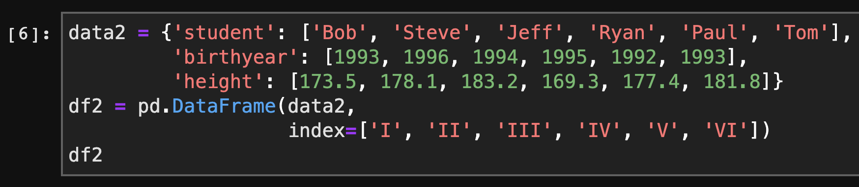
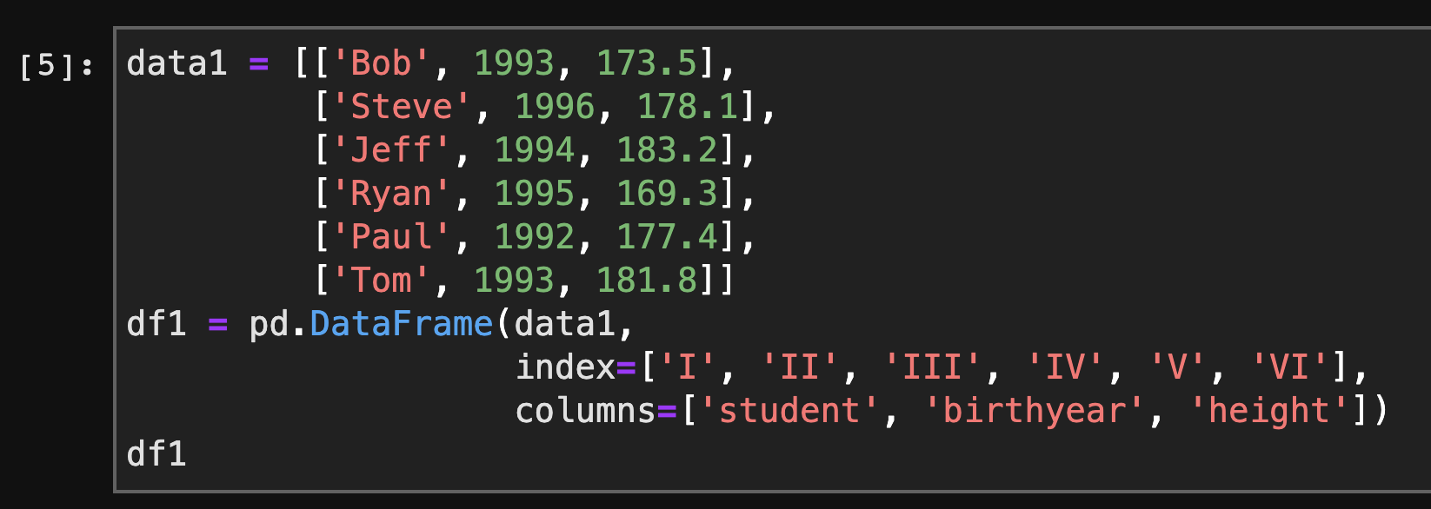
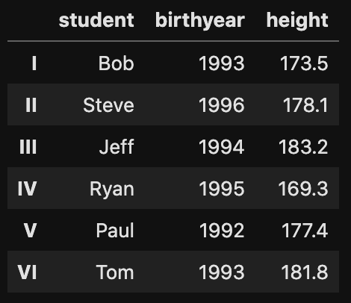
DataFrame
23
pandas.DataFrame -
Two-dimensional, size-mutable, potentially heterogeneous tabular data.
Dictionary
List
Get index and columns:
df1.index, df1.columns

Slide 7
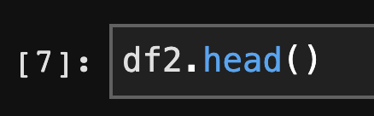
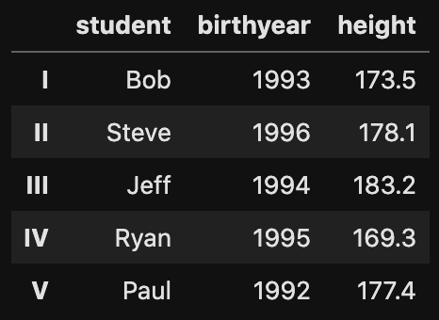
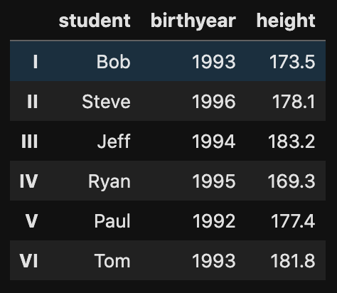
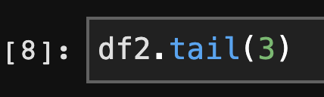
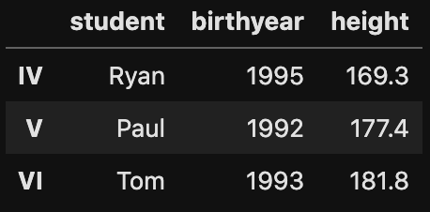
Viewing Data
23
DataFrame.head (tail) -
This function returns the first (last) n rows for the object.
5

Slide 8
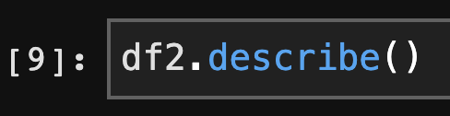
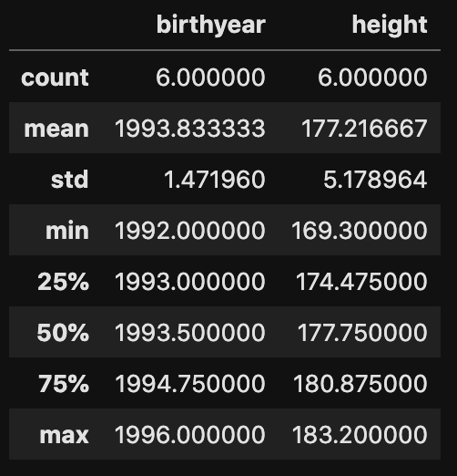
Viewing Data
23
DataFrame.describe -
Generate descriptive statistics.

Slide 9
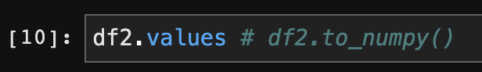
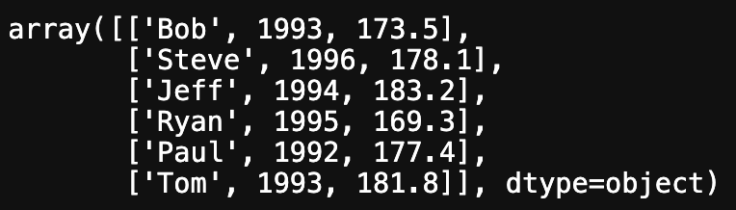
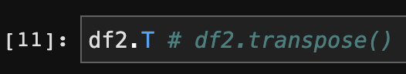
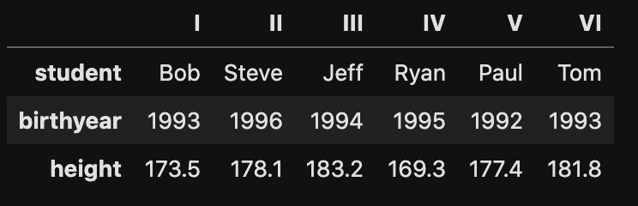
Viewing Data
23
DataFrame.values -
Return a Numpy representation of the DataFrame.
DataFrame.T -
Transpose index and columns.

Slide 10
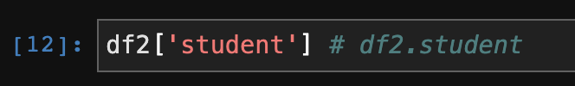
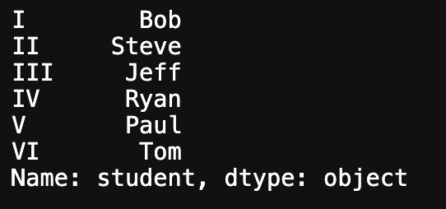
Indexing
23
Indexing into a DataFrame is for retrieving one or more columns either with a single value or sequence.
Retrieve more columns:
df2[['birthyear', 'height']]

Slide 11
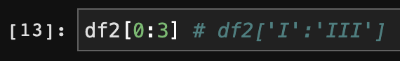
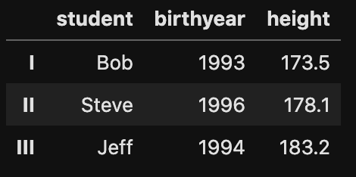
Indexing
23
Selecting data with a boolean array:
df2[df2['height'] > 175]

Slide 12
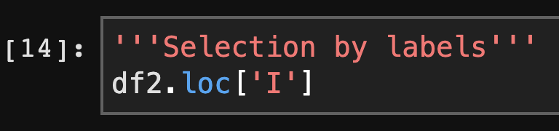
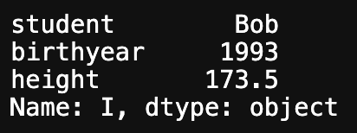
Selection
23
DataFrame.loc -
Access a group of rows and columns by label(s) or a boolean array.
Select multiple columns by labels:
df2.loc[:, ['student', 'height']]

Slide 13
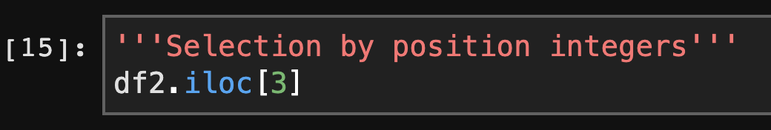
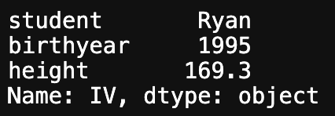
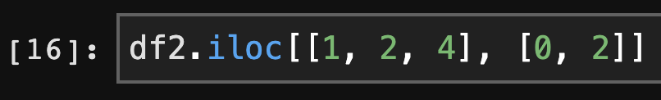
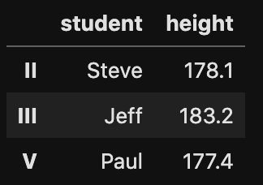
Selection
23
DataFrame.iloc -
Purely integer-location based indexing for selection by position.
Select by slicing:
df2.iloc[3:5, 0:2], df2.iloc[:4, :]

Slide 14
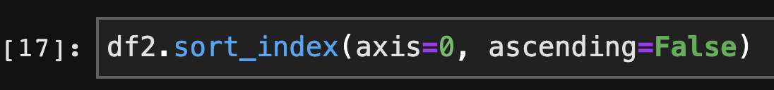
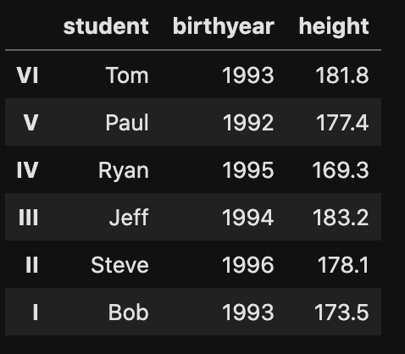
Functionality
23
DataFrame.sort_index -
Sort object by labels (along an axis).
Row: axis=0, Column: axis=1

Slide 15
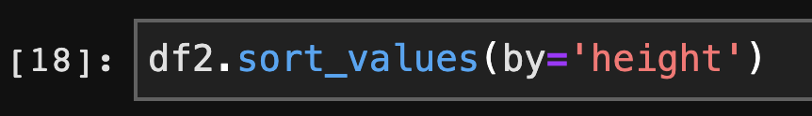
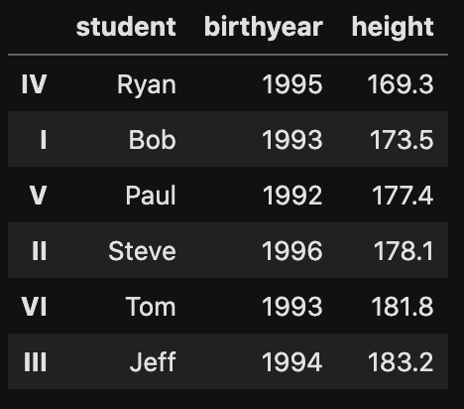
Functionality
23
DataFrame.sort_values -
Sort by the values along either axis.

Slide 16
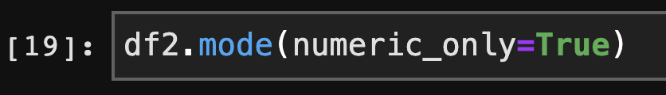
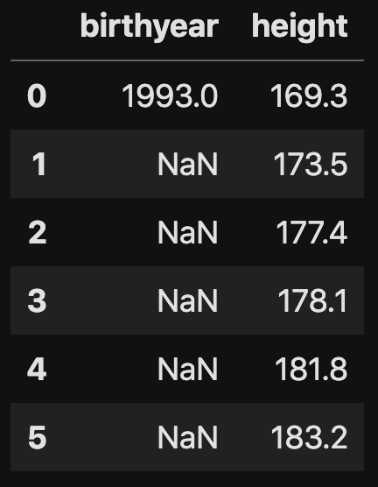
Functionality
23
DataFrame.mode -
Get the mode(s) of each element along the selected axis.
Series.mode:
df2['height'].mode()

Slide 17
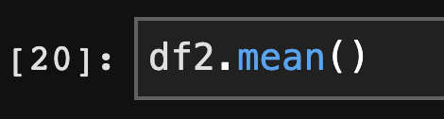
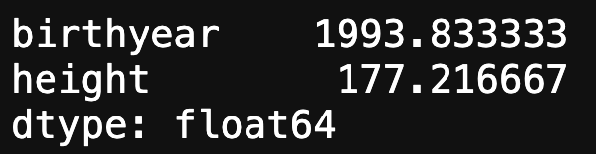
Functionality
23
DataFrame.mean -
Return the mean of the values for the requested axis.

Slide 18
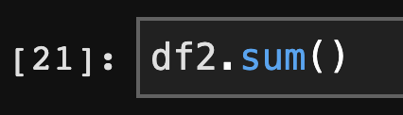
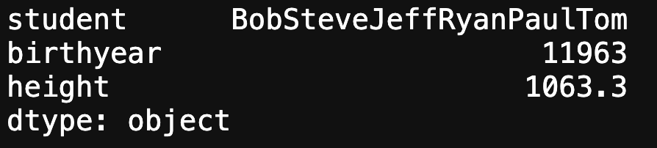
Functionality
23
DataFrame.sum -
Return the sum of the values for the requested axis.

Slide 19
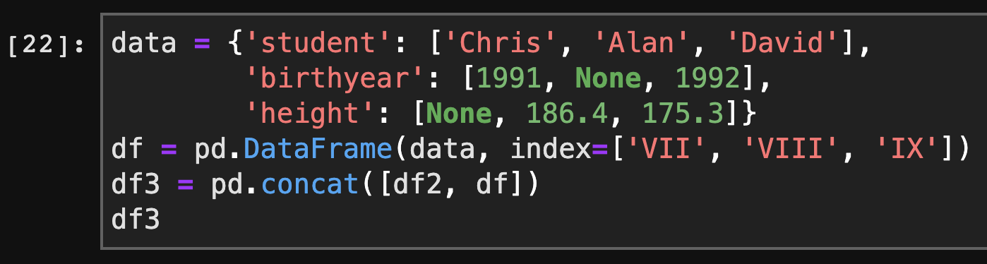
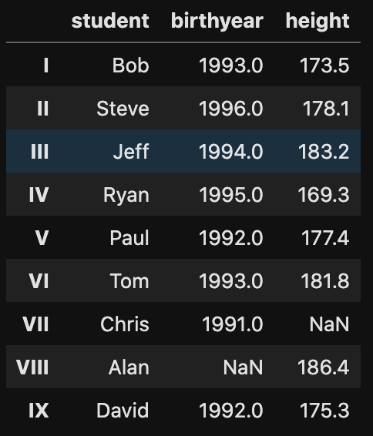
Functionality
23
pandas.concat -
Concatenate pandas objects along a particular axis with optional set logic along the other axes.

Slide 20
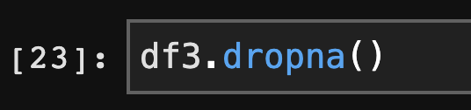
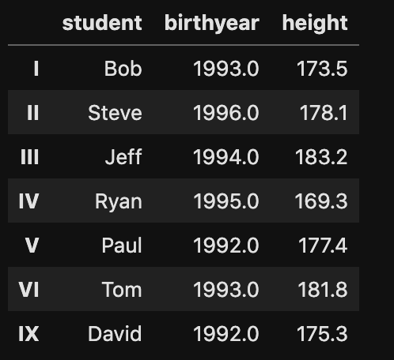
Missing Data
23
DataFrame.dropna -
Remove missing values.

Slide 21
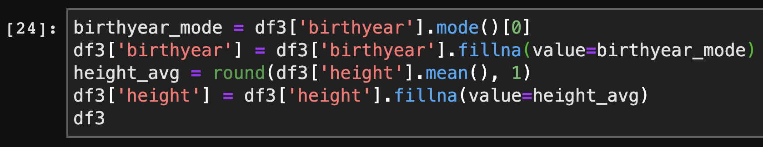
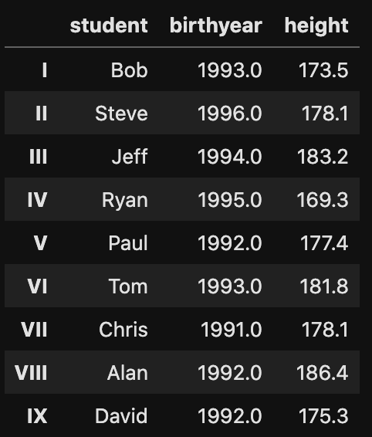
Missing Data
23
DataFrame.fillna -
Fill NA/NaN values using the specified method.

Slide 22
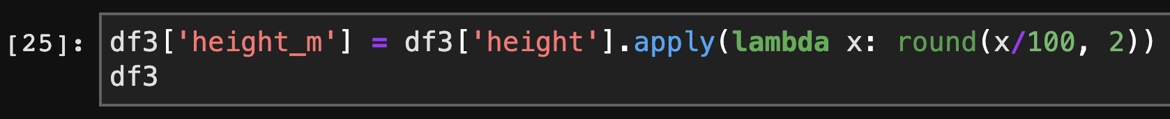
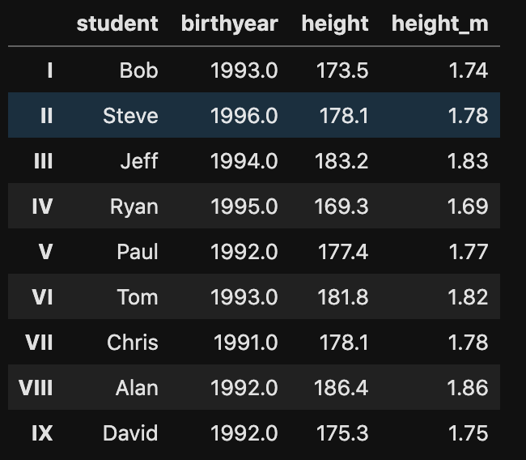
Apply
23
DataFrame.apply -
Apply a function along an axis of the DataFrame.

Slide 23

Groupby
23
DataFrame.groupby -
Group DataFrame using a mapper or by a Series of columns.

Slide 24
Matplotlib
1
https://matplotlib.org/

Slide 25



Matplotlib
1
matplotlib.pyplot.plot -
Plot y versus x as lines and/or markers.
Import

Slide 26


Figure and Subplot
1
matplotlib.pyplot.figure -
Create a new figure.
ax1
ax2
add_subplot -
Add an Axes to the figure as part of a subplot arrangement.
ax3
fig

Slide 27
Figure and Subplot
1

Slide 28


Legend
1
matplotlib.pyplot.legend -
Place a legend on the axes.

Slide 29


Ticks and Labels
1
set_xticks -
Set the x ticks with list of ticks.
set_xticklabels -
Set the x-tick labels with list of string labels.
set_title -
Set a title for the axes.
set_xlabel -
Set the label for the x-axis.

Slide 30



Plots
1
matplotlib.pyplot.hist -
Plot a histogram.
matplotlib.pyplot.bar -
Make a bar plot.
matplotlib.pyplot.plot -
Plot y versus x as lines and/or markers.

Slide 31



Plots
1
matplotlib.pyplot.scatter -
A scatter plot of y vs x with varying marker size and/or color.
matplotlib.pyplot.streamplot -
Draw streamlines of a vector flow.
matplotlib.pyplot.pie -
Plot a pie chart.

